Slide 1
Link Prediction on Bipartite Network
Student’s Name: Bijay Gaudel
Student’s ID: SL1816018
Nanjing University of Aeronautics and Astronautics

Slide 2
Introduction
This is important class in Networks, which contains edge between two types of entities, two nodes belongs to different cluster will not have any common neighbor.
Many unipartite networks can be reinterpreted as bipartite networks when edges are modeled as vertices.
Some examples of bipartite networks are:
  Item rating graphs.
  Authorship graphs
  Document feature graphs
Nanjing University of Aeronautics and Astronautics
Notes:
Social networking is the grouping of individuals into specific groups, like small rural communities or a neighbourhood subdivision and the member of this groups interaction can take many forms like sharing links to interesting content produced by third party.

Slide 3
Approach
Data
Edit-network construction
Calculate Direct Features
Feature of Node Pairs
Projection of Bipartite Network
Calculate Indirect
Features
Nanjing University of Aeronautics and Astronautics
Notes:
Link prediction is How a network evolves over time by looking at the snapshot of what is happening now and use that information to predict new connection and new collaboration in the future.

Slide 4
Approach
Edit Network Construction:
considered the Wikipedia as an undirected bipartite graph, where articles and editors are nodes in the graph. To predict the edge occurrence between an editor article pair is similar to decide whether a particular article is a good candidate to recommend to some editors.
Nanjing University of Aeronautics and Astronautics
Notes:
Link prediction is How a network evolves over time by looking at the snapshot of what is happening now and use that information to predict new connection and new collaboration in the future.

Slide 5
Approach
Feature Abstraction:
We have to abstract some features that are informative to feed into machine learning algorithm. Features can be classified as:
1) Direct Feature
2) Indirect Feature
Nanjing University of Aeronautics and Astronautics
Notes:
Link prediction is How a network evolves over time by looking at the snapshot of what is happening now and use that information to predict new connection and new collaboration in the future.

Slide 6
Feature Abstraction
Direct Feature:
Some information can be derived directly from bipartite network without any transformation and these features are called direct features. For example:
Sum of Neighbor(SN), CN, JC, AA, SD etc.
Nanjing University of Aeronautics and Astronautics
Notes:
Link prediction is How a network evolves over time by looking at the snapshot of what is happening now and use that information to predict new connection and new collaboration in the future.

Slide 7
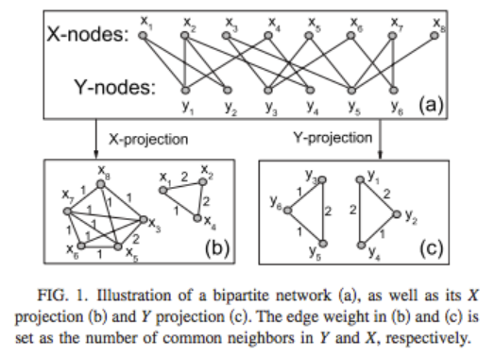
Feature Abstraction
Indirect Feature:
Nanjing University of Aeronautics and Astronautics
Notes:
Link prediction is How a network evolves over time by looking at the snapshot of what is happening now and use that information to predict new connection and new collaboration in the future.

Slide 8

Indirect Feature
A bipartite graph is defined as follows: G = <X, Y, E> where X and Y are two mutually exclusive sets of nodes. E is a set of edges of G and is a subset of X × Y.
Projections of a bipartite graph G are then defined as follows:
Nanjing University of Aeronautics and Astronautics
Notes:
Link prediction is How a network evolves over time by looking at the snapshot of what is happening now and use that information to predict new connection and new collaboration in the future.

Slide 9
Thank You
谢谢
Nanjing University of Aeronautics and Astronautics

